Slide 1
Brain-Computer Interfaces (BCIs)
Designing an adaptive video game for children with ADHD
Liudmila Tahai

Slide 2
Outline
Introduction
BCI model
BCI types
Applications
Advantages and Disadvantages
Proposed Research
Motivation
Research Objectives
Game Design
Proposed Methodology

Slide 3
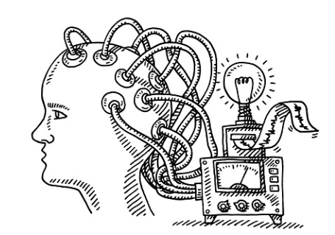
Introduction
BCIs are designed to create a direct pathway between the human brain and the computer
Notes:
In other words, brain-computer interfaces extract electro-physical signals from our brain, translate them (process those signals to generate control signals) into control signals for computers, robotic machine or other BCI-based communication devices.

Slide 4
BCI Historical Background
1924, Hans Berger, a German psychiatrist recorded human brain activity using EEG
1970, Defense Advanced Research Projects Agency of USA initiated programs to explore brain communications using EEG
1977, Jacques Vidal, a UCLA professor, coined the term “BCI” and produced first peer-reviewed publications on this topic
1990s following years of animal experimentation, the first neuroprosthetic device was implanted in human brain
2004, Matthew Nagel was the first person to use a BCI to restore functionality lost due to paralysis
Notes:
Jacques Vidal described an experiment using noninvasive EEG control of a cursor-like graphical object on a computer screen. Last year, he presented a lecture on his early BCI work at the six annual bci conference that took place in Pacific Grove.
Animal experimentation such as implanting electrodes into monkeys’ brains and recording their brain activity to reproduce movements in robotic arms
Matthew was paralyzed from the neck down after being stabbed, and thanks to BrainGate Neural Interface System developed by Cyberkinetics was able to communicate with the outside world, for example, check emails, or control TV

Slide 5
BCI Historical Background
2008, voiceless phone calls are demonstrated using Audeo neckband
2013, researchers at Duke University successfully connected brains of two rats in the first ever brain-to-brain interface
Notes:
Audeo neckband is a device that picks up signals sent by brain to vocal cords and translates those signals into meaningful electronic speech without a sound escaping from a person’s mouth
B2B interface enabled a real-time transfer of behaviorally meaningful sensorimotor information between the brains of two rats

Slide 6
How BCI works?
The brain is full of neurons that connect with each other to form a super highway for nerve impulse
The speed of nerve impulses can reach up to 395 feet per second
The electrical signals in brain are interpreted by EEG-based devices and translated into commands
Notes:
The brain is full of neurons that are connected to each other by dendrites that receive signals from other neurons to the cell body, and axons that take signals away from the cell body. This essentially “input-output” super highway for nerve impulses allows electrical signals to travel from neuron to neuron to produce thought, hearing, speech, or movement. The speed of nerve impulses can reach up to 395 feet per second, but even this top speed is 3 million times slower than the speed of electricity through a wire, so no worries.:)

Slide 7
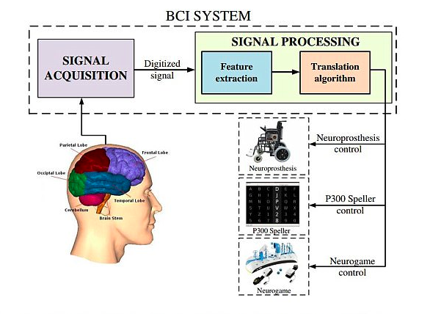
Basic block diagram of a typical BCI

Slide 8
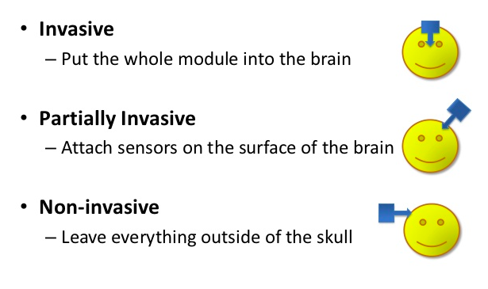
BCI Types

Slide 9

BCI Types
Notes:
Invasive BCI are implanted directly into the grey matter of the brain during neurosurgery. They produce the highest quality signals but prone to scar tissue build up in the area that can affect the quality of signal

Slide 10
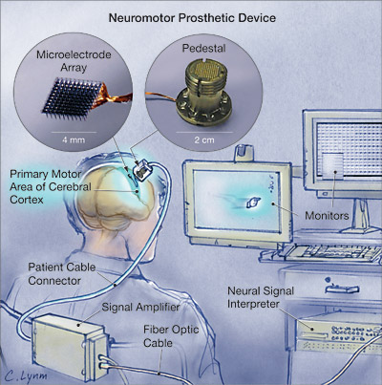
Invasive BCI

Slide 11
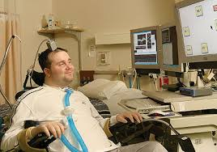

Invasive BCI
Notes:
Matt was able to control a robotic arm by thinking about moving his hand as well as a computer cursor, lights and TV.
Jens was able to use his imperfectly restored vision to drive an automobile slowly around the parking area of the research institute.

Slide 12

BCI Types
Notes:
It is another brain signal reading process which is applied to the inside the skull but outside of the grey matter. The example of partially invasive BCI device would be Intracranial electroencephalography or Electrocorticography. The device records the activity of the brain inside the skull but from the surface of membrans that protect it.

Slide 13
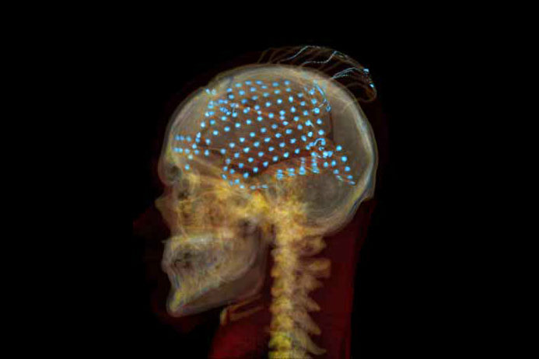
Partially Invasive BCI
Notes:
The good thing is that such BCI devices have a lower risk of forming scar-tissue in the brain than fully invasive BCIs. But again the electrode grid is implanted surgically. Ethical considerations still there.

Slide 14

BCI Types
Notes:
The most useful neuron signal imaging method which is applied outside of the skull, just applied on the skulp. The techniques used are EEGs or conventionall scalp electroencephalographs, MEGs (magnetoencephalography detects tiny magnetic fields created as individual neurons fire within the brain), fMRIs (functional magnetic resonance imaging that measures brain activity by detecting changes associated with blood flow.This technique relies on the fact that cerebral blood flow and neuronal activation are coupled. When an area of the brain is in use, blood flow to that region also increases.)

Slide 15
Non-invasive BCIs (MEG and fMRI)

Slide 16
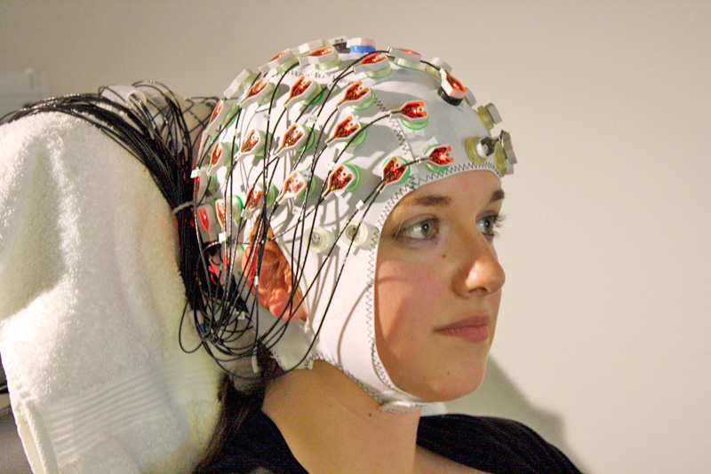
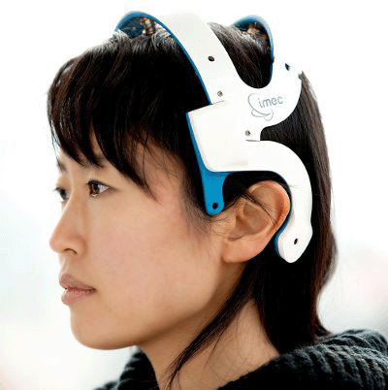
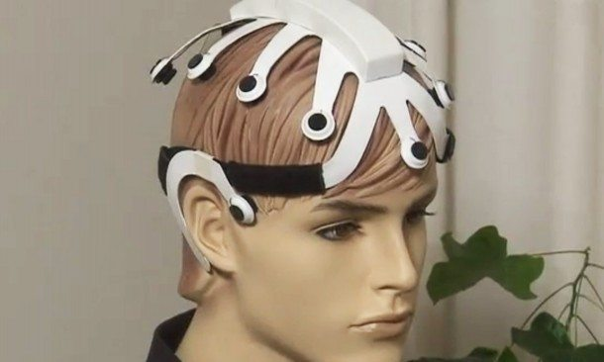
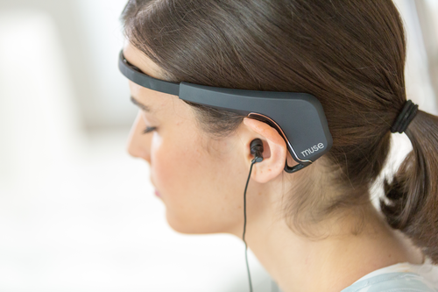
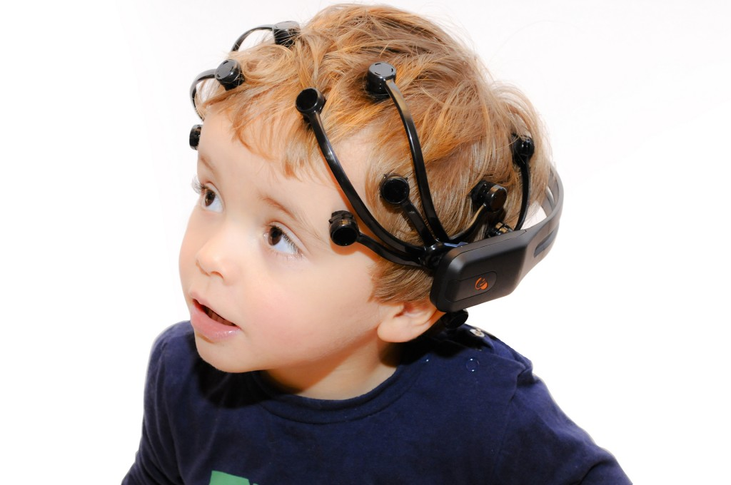
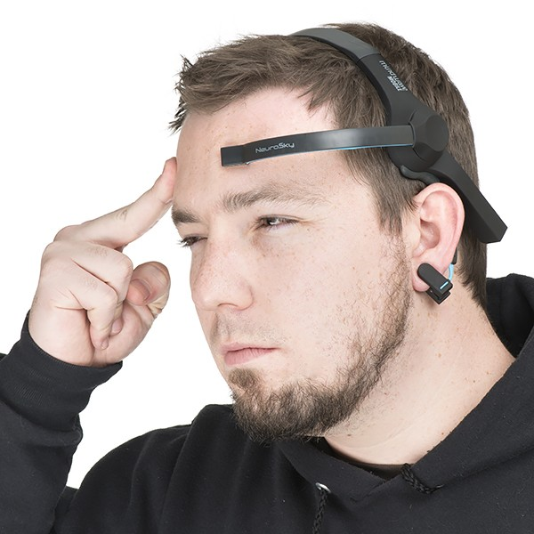
Non-invasive BCIs (EEG-based)
Notes:
Here you can see different EEG devices, such as clinical EEGs with wet electrodes, which require conductive gel, and mobile EEGs with dry electrodes.

Slide 17
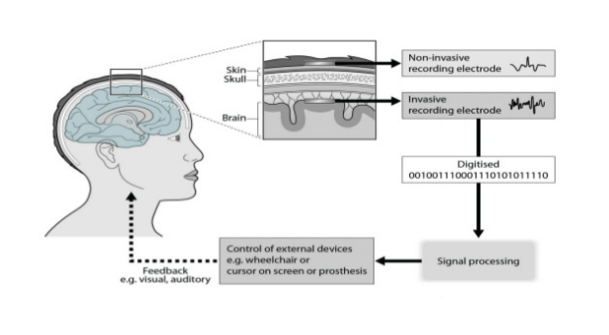
BCI Types
Notes:
Here you can see the difference between the quality of the signal a researcher can obtain using non-invasive electrodes and invasive electrodes

Slide 18
Applications
Communication, environment control, movement restoration for disabled people
Control of devices such as wheelchairs, assistant robots and vehicles
Additional channel of control, and attention monitoring of players in video games
Attention monitoring of long-distance drivers and pilots
Control robots in dangerous or inhospitable situations (e.g. underwater or in extreme weather conditions)
Stages of sleep monitoring, dream capture, bionics/cybernetics
Notes:
Communication, environment control, movement restoration for disabled people
Control of devices such as wheelchairs, assistant robots and vehicles
Additional channel of control, and attention monitoring of players in video games
Attention monitoring of long-distance drivers and pilots
Control robots in dangerous or inhospitable situations (e.g. underwater or in extreme weather conditions)
Stages of sleep monitoring, dream capture, bionics/cybernetics

Slide 19
Advantages of BCIs
…..
Notes:
Eventually, BCIs will allow paralysied people to control prosthetic limbs with their minds, transmit visual images to the mind of a blind person or auditory data to the mind of a deaf person, allow gamers to control video games with their minds, allow mute person to have their thoughts displayed and spoken by a computer

Slide 20
Disadvantages of BCIs
…...
Notes:
BCI research is still in beginning stages, the current technology is rather crude, ethical issues may slow down research development, health considerations when we talk about invasive BCIs

Slide 21
Conclusion
BCI requires intense R&D to attain intuitive efficiency
Notes:
BCI is an advancing technology promising paradigm shift in areas like Machine Control, Human Enhancement, Virtual Reality. So, potentially, it is a high impact technology

Slide 22
Proposed Research
Motivation
Research Objectives
Game Design
Proposed Methodology

Slide 23
Designing an Adaptive Video Game for Children with Attention Deficit Hyperactivity Disorder: Learning Proportional Reasoning through Play
MSc Thesis Proposal
Liudmila Tahai
School of Public Health and Health Systems
Faculty of Applied Health Sciences
University of Waterloo

Slide 24
Attention-deficit-hyperactivity disorder (ADHD)
heritable neurodevelopmental disorder
commonly diagnosed in childhood
affects 5 to 12 % of school-aged children (CADDRA, 2013)
persists into adulthood in 30-50% of cases
first described by George Still, English pediatrician, in 1902
impaired cognitive profiles

Slide 25
Attention-deficit-hyperactivity disorder (ADHD)
risk of low academic achievements (Anastopoulos et al., 1993)
71% of children with ADHD have learning disabilities of which 26% experience learning disabilities in mathematics (Mayes and Calhoun, 2006)
affected reasoning (in particular, mathematical reasoning) and problem solving abilities

Slide 26
Proportional reasoning
Essential form of mathematical reasoning, as it is an ability to think about numbers in relative, rather than absolute terms
Compex way of thinking influenced by biological (working memory capacity) and environmental (physical experiences) factors (Kwon et al. 2000)
Crucial skill not only in academic performance but in everyday decision making (e.g. adjust recipes)

Slide 27
Proportional reasoning
Proportional reasoning skills require learning and can be improved by training
10-year-old children experience difficulty inventing proportionality rules, however, children as young as 7 were found to learn these rules easily (Siegler, 1978)

Slide 28

Classical approach to ADHD management
Medications, such as stimulants and antidepressants
They do not bring benefits once the drug has been withdrawn (Swanson & Volkow, 2009)
Side effects include sleeping problems, moodiness and irritability that negatively affect learning

Slide 29
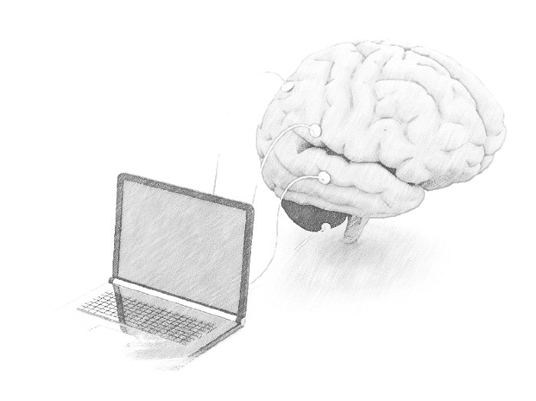
Nonpharmacological interventions
Dietary treatment
Parent training
Behavioral therapy
Neurobiofeedback
Videogames
Issue: Openness to alternative disorder management methods

Slide 30
Nonpharmacological interventions
Videogames can be powerful tool to train brain as they improve working memory (Strobach, 2012)
Testing different solutions to a problem and finding them ineffective motivates children to look for new strategies (Kwon, 2000)
Notes:
A number of studies (Lubar & Swartwood, 1995; Thompson & Thompson, 2005) confirmed that a non-medication alternative, when a person with ADHD learns to self-regulate brain wave activity in order to manage the symptoms, brings long-lasting effects (in some case with 10-year follow-up). Such non-medication interventions that employ computer technology to train the brain are called neurotherapy or neurofeedback

Slide 31
Research Objectives
Design and validate a videogame that teaches proportional reasoning to children with ADHD
Verify whether children with ADHD are kept longer in the state of flow by manipulating the difficulty of the game based on their attention level as read by the low-cost BCI device

Slide 32
Design Challenges
Different cognitive profiles of ADHD
Easily distracted
Easily over stimulated and over excited
Information retention issues
Cost of the BCI devices

Slide 33
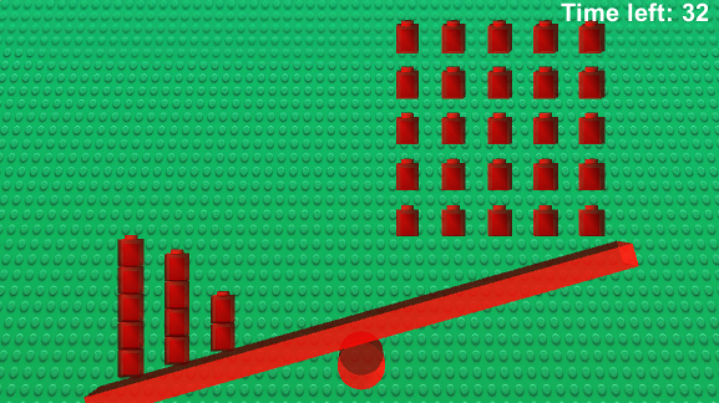
Game Design 1
The initial Lego balance scale design of the game to test the EEG device inspired by Siegler’s balance scale experiment (Siegler, 1976)
Notes:
Describe the game and why it is proportional reasoning game

Slide 34
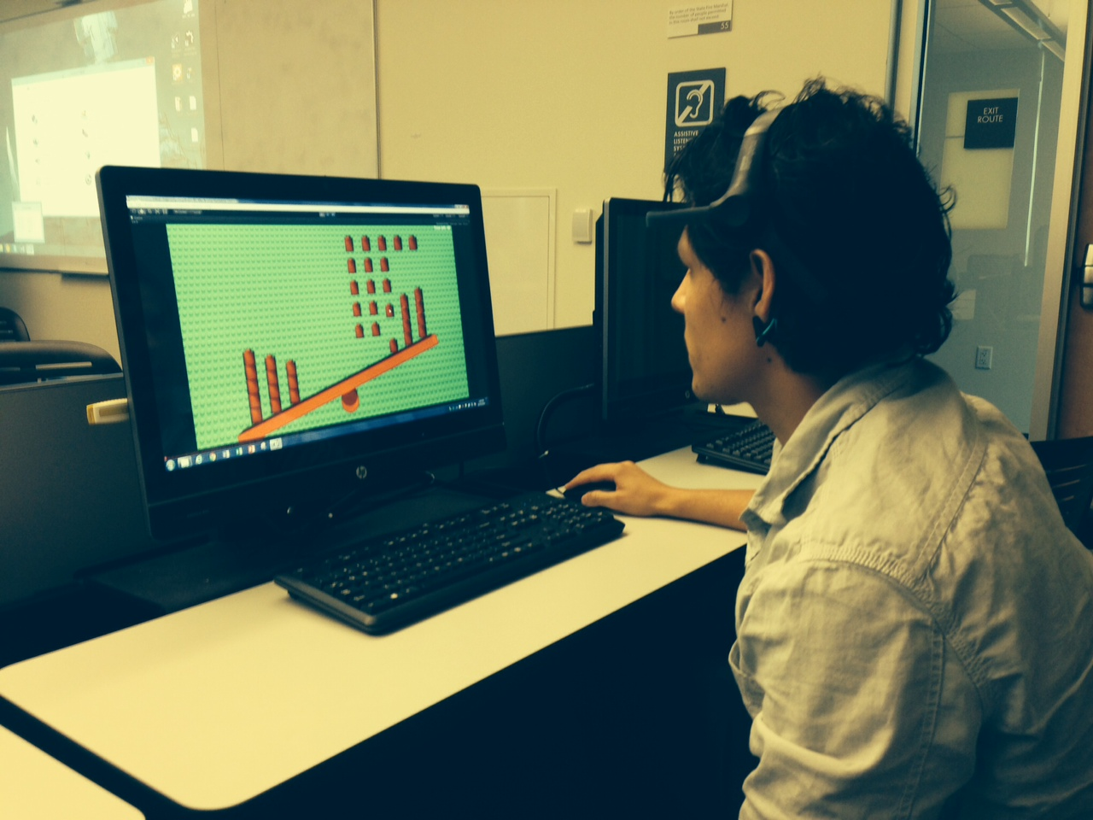
Game Design 1
Siegler’s proportionality rules are introduced in a specific order:
1. weight introduction
2. distance introduction
3. considering both weight and distance
4. sum of cross products

Slide 35
Pilot Study
7 participants aged 19 to 22 years (M=20.57, SD=1.13)
moderate correlation between the sum of blocks and the attention readout for positive (successful) trials, r(35)= .49, p < .002; and, for negative trials, r(15)= .5, p < .04.
moderate correlation between the completion time and the attention readout for negative (unsuccessful) trials, r(15)= .52, p < .03.

Slide 36
Game Design 2
Single player brain-computer interface based video game inspired by Lego
The player is offered a balance scale that represents of itself a bridge made of lego blocks
5 positions on each side of the bridge with spare single Lego blocks resting on the platform beneath the deck of the bridge
The example combination of blocks is offered on the left side of the bridge

Slide 37
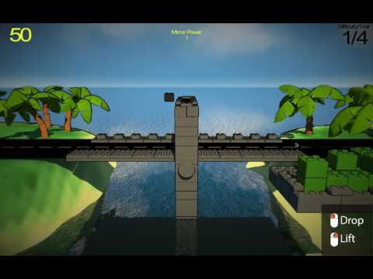
Notes:
Video instead of picture

Slide 38
Use of the EEG device
The brain activity data is collected using a mobile electroencephalogram called Neurosky MindWave headset
The data from the EEG device is sent over Bluetooth to the computer
The headset is accessible, easy to use by a child and affordable

Slide 39
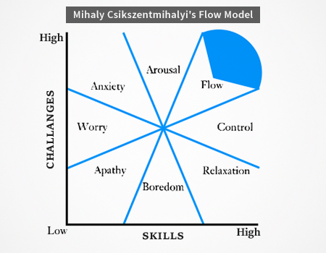
Use of the EEG device
BCI is used to get objective measurements of the state of flow (attention and meditation)
Notes:
I assume that by measuring attention and combining it with results(wins or losses) I may be able to keep children in the flow channel better than in the regular, level by level, game play

Slide 40
Adaptive Difficulty
Focused and winning -> go level up
Focused and losing -> repeat the level
Not focused and winning -> go two levels up
Not focused and not winning -> repeat the level
3 recent trials rule: win win loss (winning), win loss win (winning), win loss loss (losing)

Slide 41
Hypotheses
The children with ADHD will enjoy the adaptive flow theory based video game better compared to the control group
The adaptive flow theory based video game will enhance self-monitoring of symptoms more than the regular video game.

Slide 42
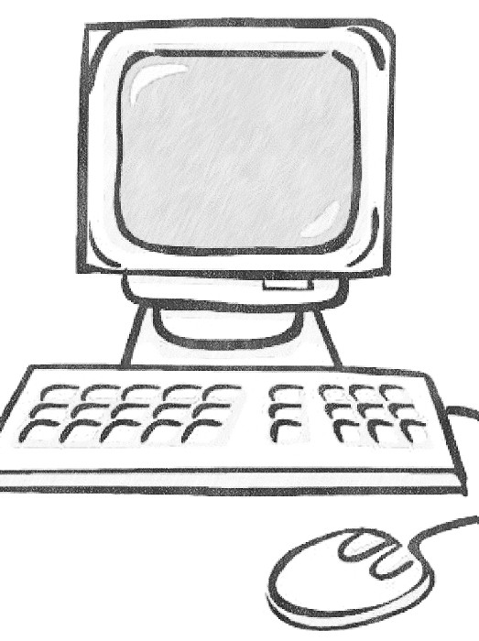
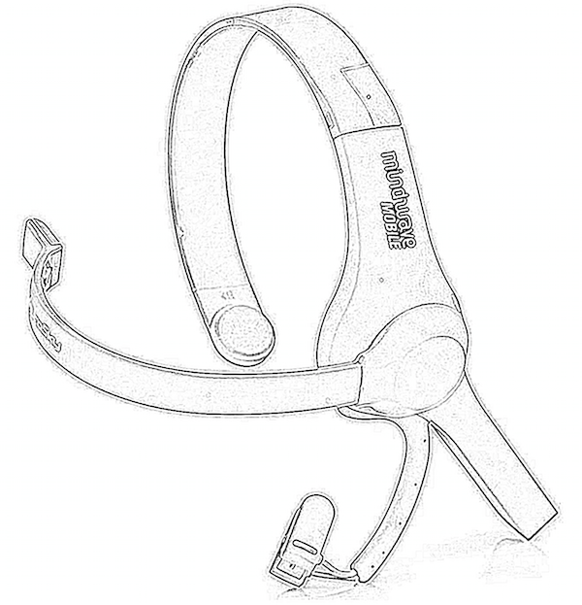
Method
Between-subjects design
2 groups (experimental adaptive game and control)
40 minutes (5 minutes training and 35 minutes game play)

Slide 43
Method
Experimental group:
7 difficulty levels (Christel et.al, 2013), max 35 trials
60 seconds per trial
Progress to next level adaptively, averaging over 3 recent trials
3 recent trials rule: win win loss (winning), win loss win (winning), win loss loss (losing)
Control group:
7 difficulty levels (Christel et.al, 2013), 35 trials
60 seconds per trial
Progress to next level of difficulty only when the current level of difficulty is completed

Slide 44
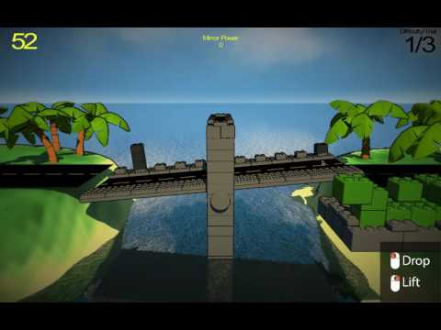

Slide 45
Data collection
Attention and Meditation
Level Completion Status
Duration of task play
Configurations of the left and right sides
Sum of weights on the left side
Star-rating at the end of each trial
Flow questionnaire

Slide 46
Summary
The goal of the proposed Master’s thesis is to design an adaptive videogame that teaches proportional reasoning to children with ADHD
The use of the EEG by NeuroSky provides information about the participant’s state of flow (attention and meditation state) while playing the game
The Lego inspired videogame is using the difficulty levels described and tested by Christel (2013)
Proportionality rules in the videogame are introduced in accordance with Siegler’s mental models (1976)
Notes:
The goal of the study, bci interface, experiment description in general

Slide 47
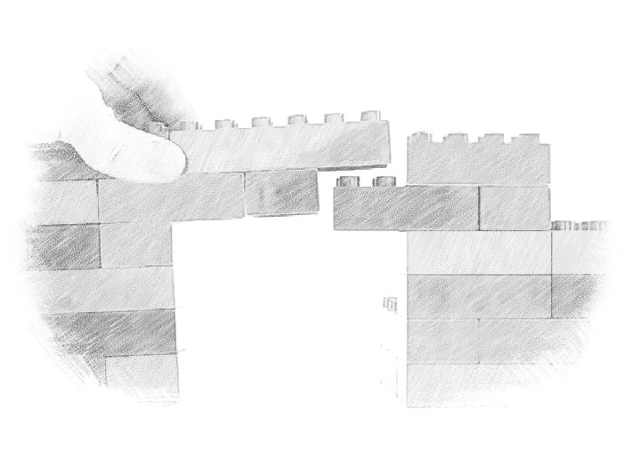
Thank you for your attention!

